Slide 1
Measuring solubility

Slide 2
The temperature affects the amount of a substance that dissolves in a solvent.
The solubility of a solute is the maximum amount in grams that can dissolve in 100g of the solvent at a given temperature.
The solution in which no more solute can be dissolved in a solvent at a particular temperature is known as a saturated solution. Before this point it is known as an unsaturated solution.

Slide 3
If the solvent water is heated, then more solute can be dissolved. If the heated solution is allowed to cool, crystals will start to precipitate again. The temperature at which this happens is the temperature at which the solution is saturated.
Supersaturated solution
A solution can become supersaturated when there is more solute dissolved than in a saturated solution at the same temperature.

Slide 4
Toffee is a supersaturated solution of sugar. To stop the toffee crystallising, a mixture of sugars or the addition of some fats can be used to stabilise the solution.

Slide 5
Aqueous solutes that produce ions when dissolved in water are classified as electrolytes as follows:
Strong electrolytes: When these dissolve in water they are entirely present ( or at least mostly) as independent mobile ions.
E.g. NaCl, Ca(NO3)2
Weak electrolytes: When these dissolve in water they are partly present as independent mobile ions
E.g.CH3COOH, H2S
Non-electrolytes: When these dissolve in water they do not produce ions
E.g.O2, I2

Slide 6
Equations of solvation
When an ionic electrolyte dissolves, the ions present within the ionic solid are released into water to form a solution of independent mobile ions. This process is termed as dissociation.
The formation of ions by a molecular electrolyte is a different process known as ionisation.
During ionisation, molecules of the electrolyte ( e.g.HCl, H2SO4 ) react with water to form ions not originally present within the substance.

Slide 7
Pure water is a non-conductor of electricity, however, aqueous solutions that contain a dissolved electrolyte will conduct.
Electrical conductivity in a solution depends on the ability of positive ions to move freely towards the negative electrode while negative ions move freely towards the positive electrode. Thus the greater the concentration of ions in a solution the greater is its ability to conduct a current.

Slide 8
Ionic solubility and solvation
The solubility of substances in water, including ionic and polar and non-polar molecular substances, can be explained by the intermolecular forces, including ion-dipole interactions between species in the substances and water molecules. (Syllabus)
The solubility of ionic compounds depends largely on the solvation properties of polar solvents. Solvation involves the attraction of polar solvent molecules to both the positive and negative ions of an ionic solid. The highly polar nature of water molecules allows water to be excellent solvent for many ionic solutes.
Solvation by water is known as hydration. It occurs because of the electrostatic forces of attraction, called ion-dipole forces, that form between an ion and the dipole of a water molecule. This involves the slightly positive hydrogen atoms in a water molecule being attracted to a negative ion while the slightly negative oxygen atom in the water molecule is attracted to appositive ion. These ion-dipole forces lead to hydration where each ion in solution is surrounded by several water molecules.

Slide 9
The high solubility of many ionic solids in water is largely due to the ion-dipole forces overcoming the strong attractive between oppositely charged ions in the ionic solid.

Slide 10
Solubility curves
A graph showing how much of a solute such as a salt can be dissolved at a particular temperature provides useful information on the solubility of a substance. As temperature increases more salt will dissolve. This graph is called as solubility curve.
The amount of solute is measured in grams of solute in 100 grams of water.

Slide 11
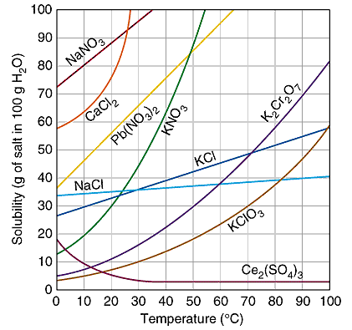
A selection of solubility curves for various salts

Slide 12
Gas solubility curves
Solubility of gases can be shown with the help of solubility curves. As temperature increases, solubility of non-polar gases generally decreases. Solubilities are much lower than that for solids and values are shown in parts per million(ppm).

Slide 13
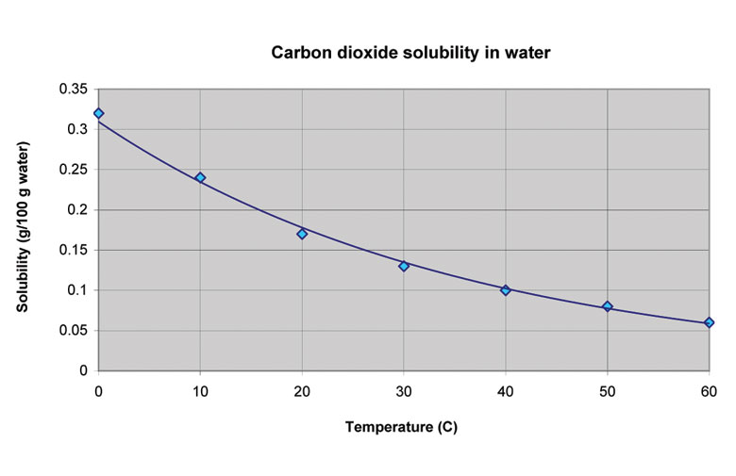

Slide 14
Concentration units
Solubility curves use the unit grams of solute per 100g of water.
Concentration is a measure of the amount of solute present.
There are a variety of units in general use; g/100g,
%v/v ( per cent by volume),
% w/w (per cent by weight),
%v/w, ppm (parts per million, grams of solute in one million grams of solution)

